Slide 1




April 5 Meeting
Luke Bell, Yan Wang, Kevin Smith, Eugene Dumitrescu, Yuan Liu, Steven Girvin

Slide 2
Topics to Discuss
1. Clarification of notation for operators
2. Recursive application of VTA to initial state
Analytically-derived asymptotes for simulations
3. Spectrum of VTA
Interesting effects of complex eigenvalues

Slide 3
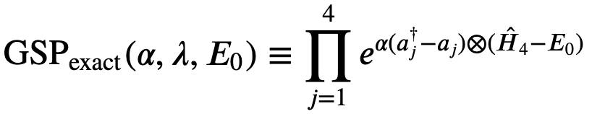
1. Clarification of Notation

Slide 4
1. Clarification of Notation

Slide 5
1. Clarification of Notation

Slide 6
1. Clarification of Notation

Slide 7
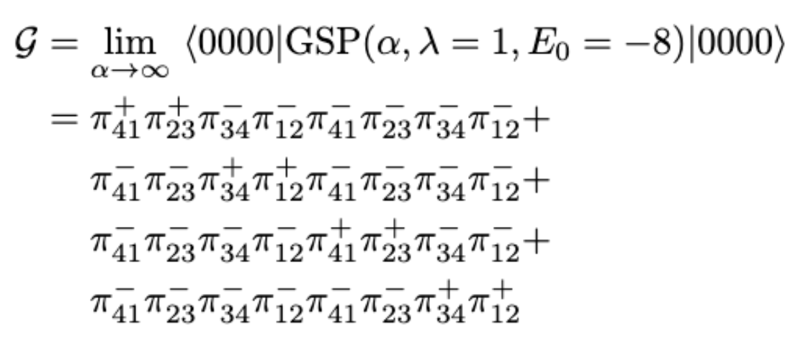
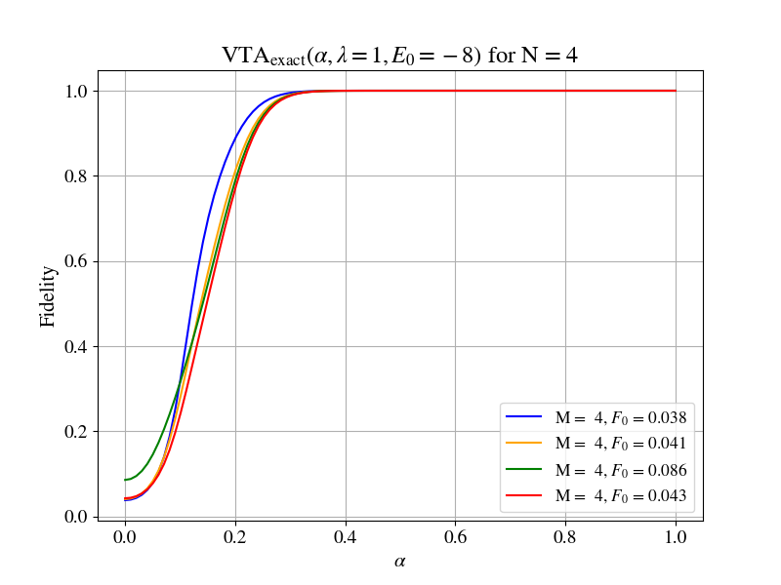
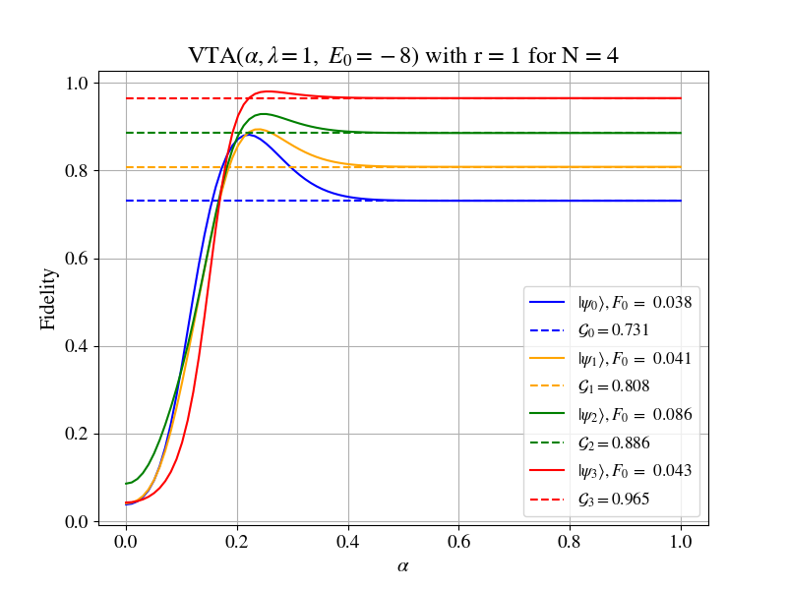
VTA Data with r = 1

Slide 8
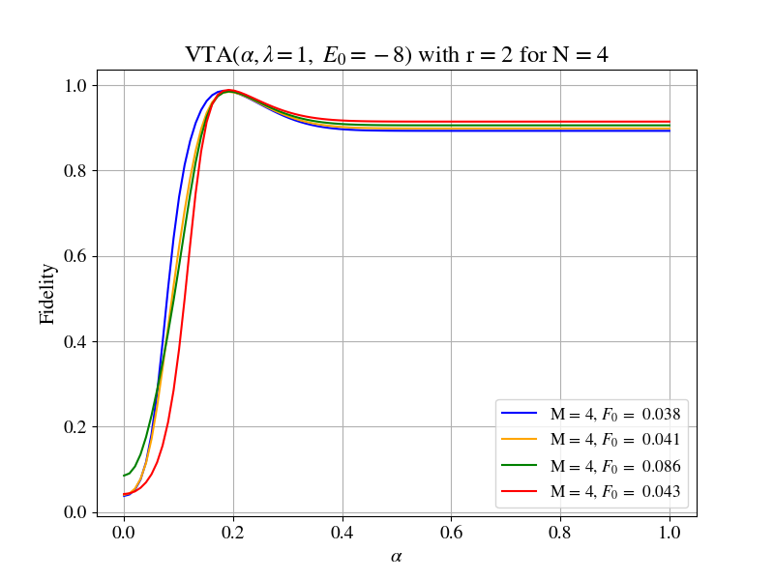
VTA Data with r = 2

Slide 9
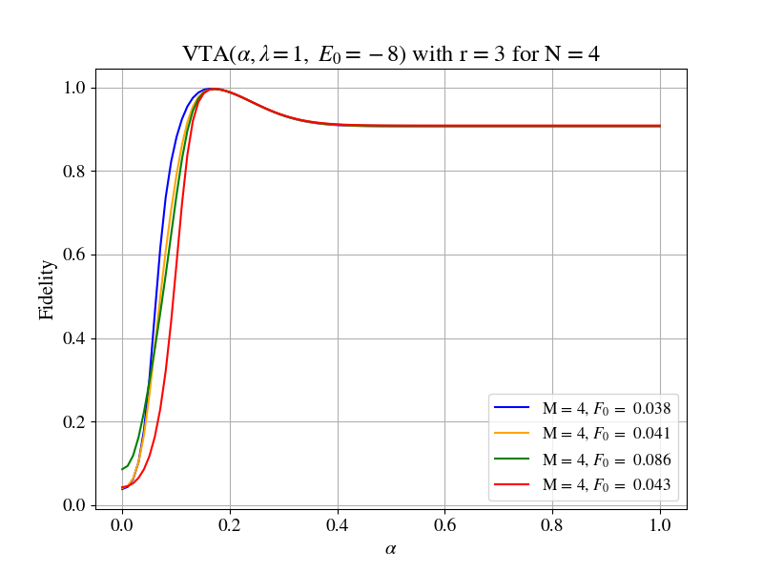
VTA Data with r = 3

Slide 10
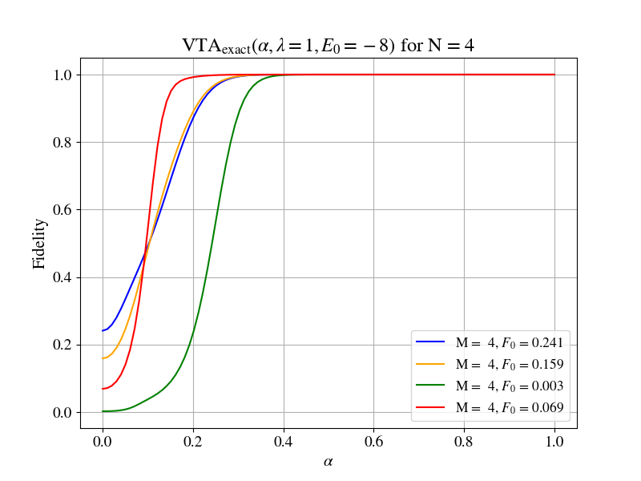
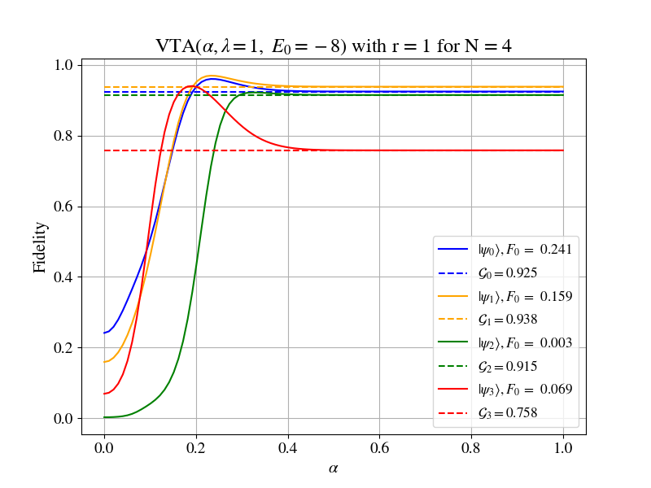
More VTA Data with r = 1

Slide 11
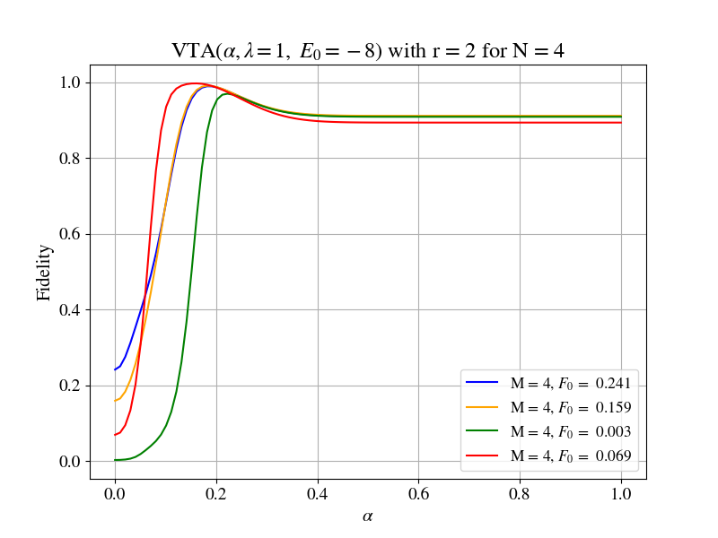
More VTA Data with r = 2

Slide 12
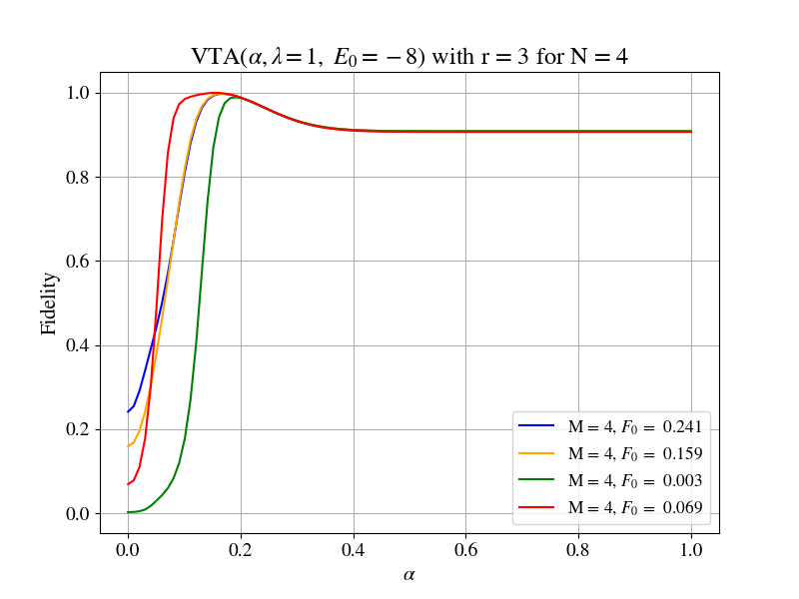
More VTA Data with r = 3

Slide 13
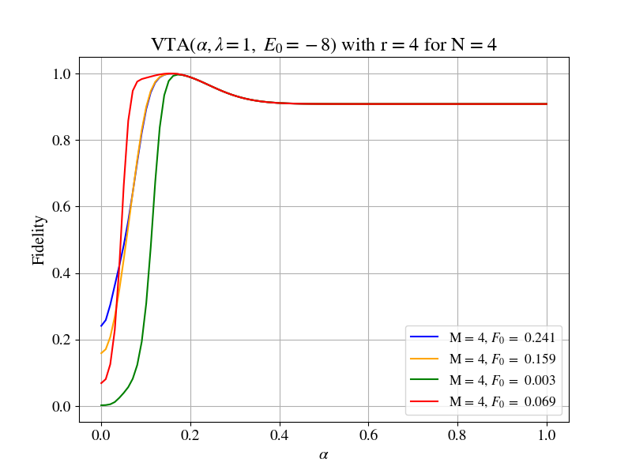
More VTA Data with r = 4

Slide 14
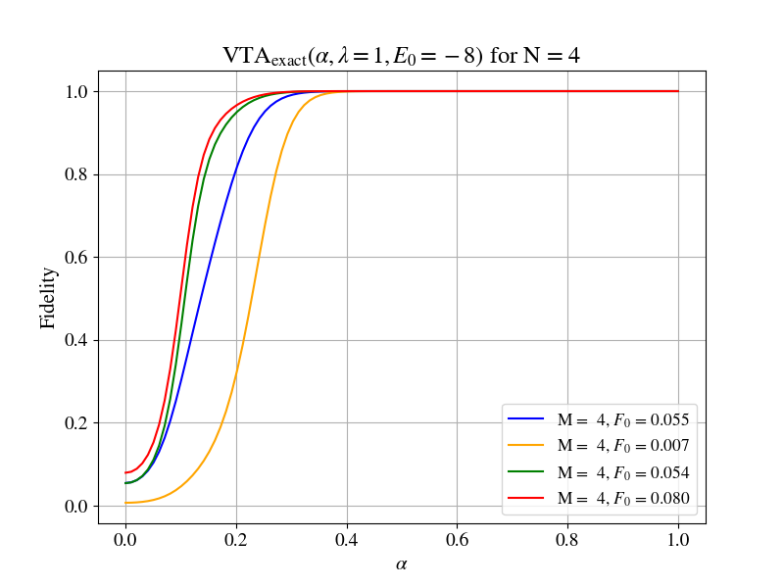
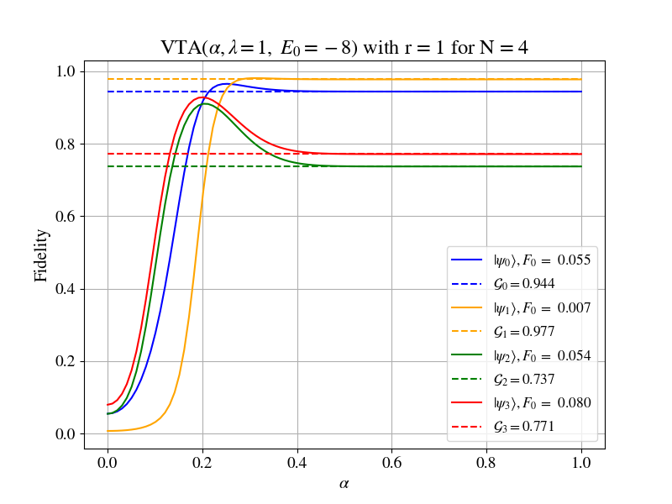
Last round of VTA Data with r = 1

Slide 15
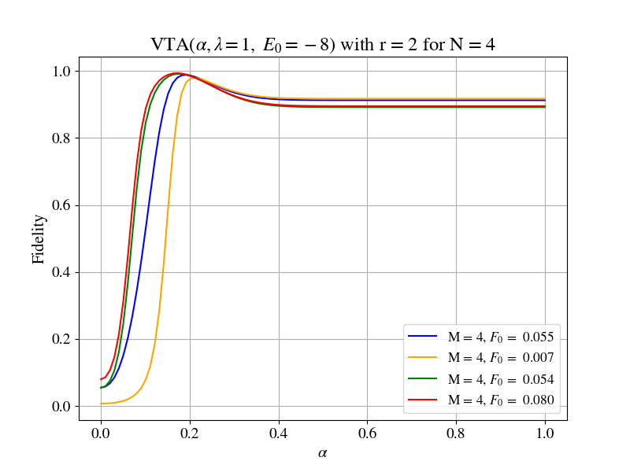
Last round of VTA Data with r = 2

Slide 16
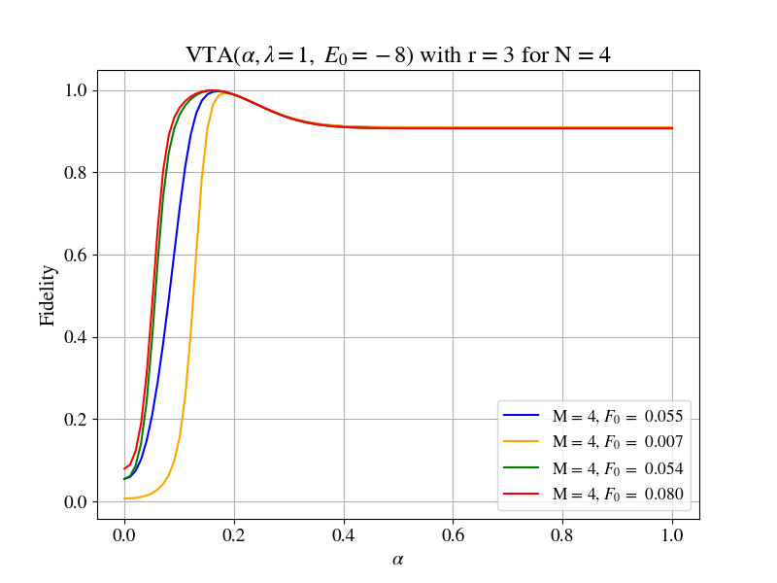
Last round of VTA Data with r = 3

Slide 17
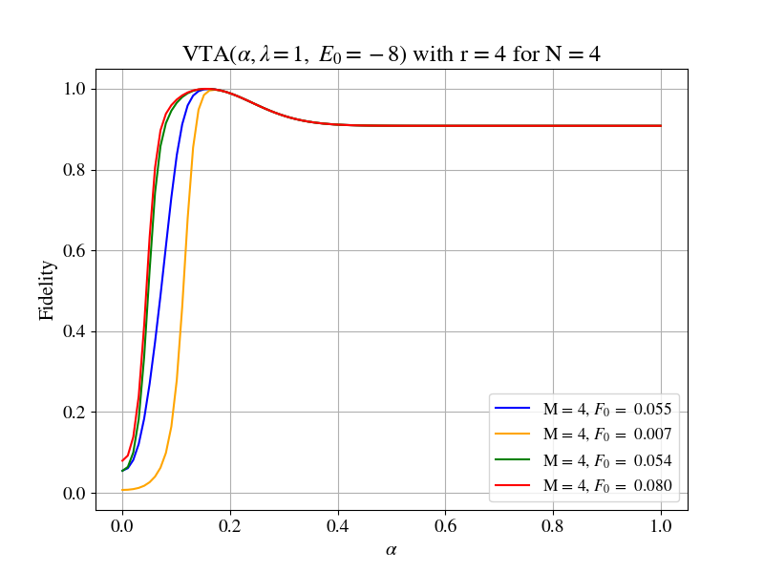
Last round of VTA Data with r = 4

Slide 18
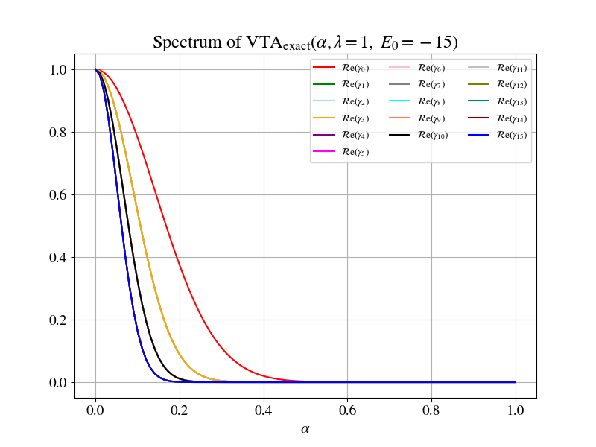
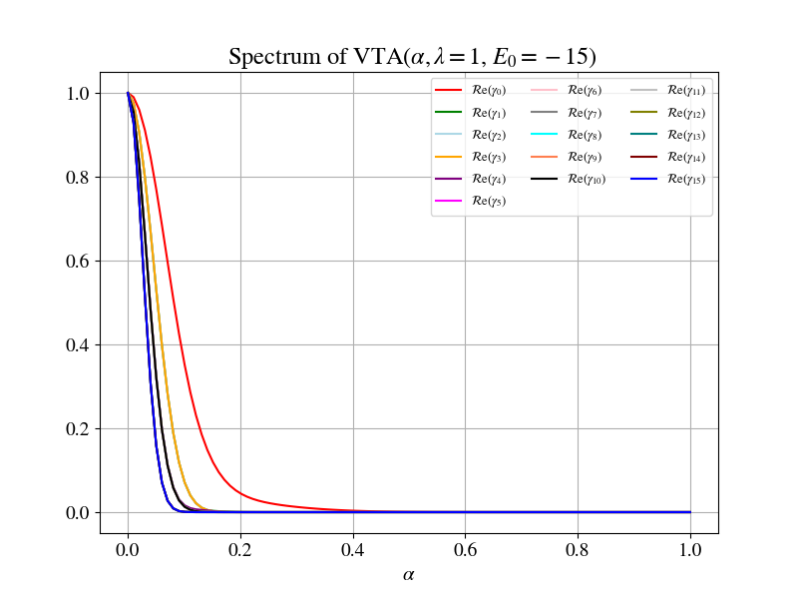
Spectrum for λ=1, E₀ = -15

Slide 19
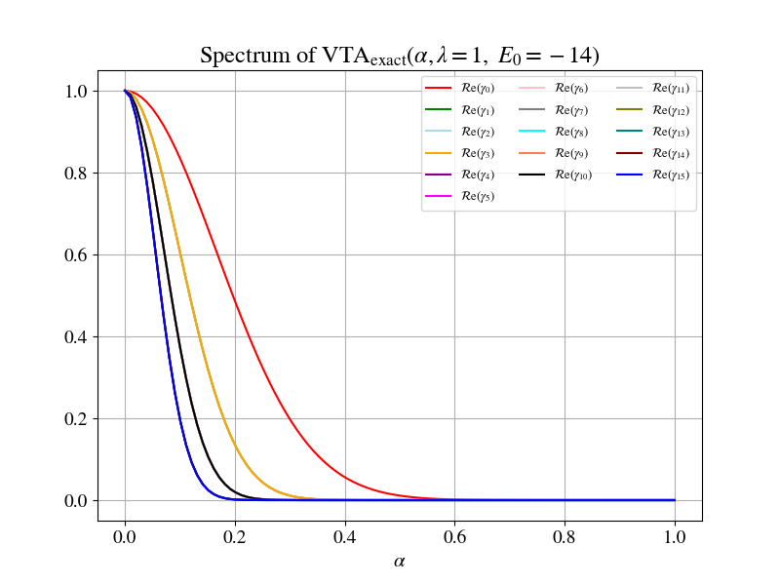
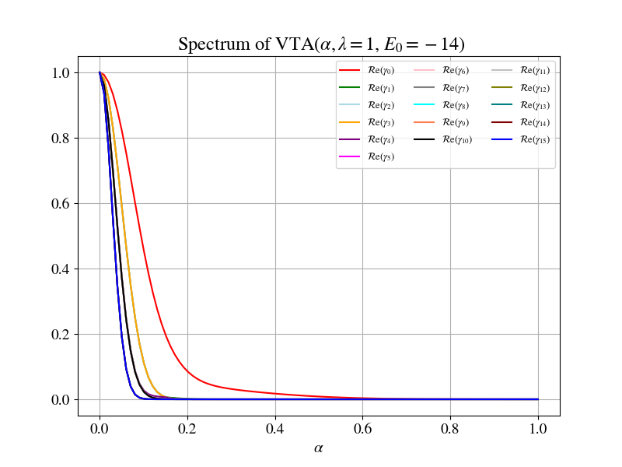
Spectrum for λ=1, E₀ = -14

Slide 20
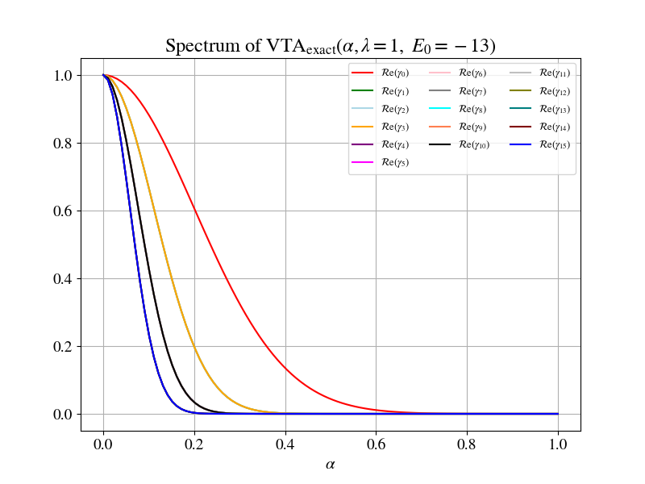
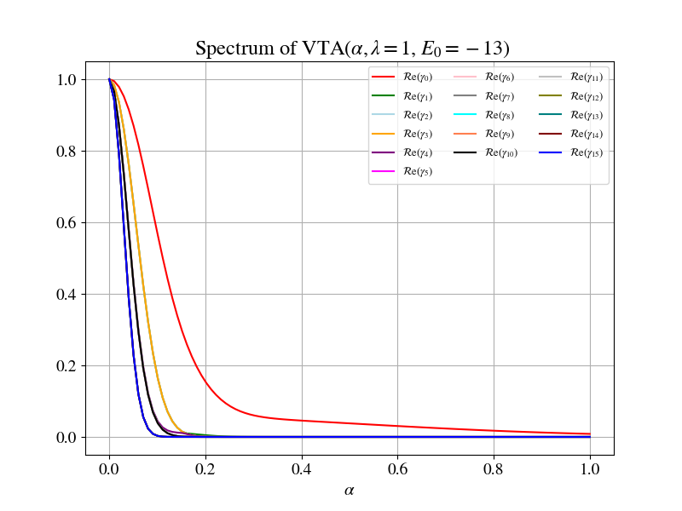
Spectrum for λ=1, E₀ = -13

Slide 21
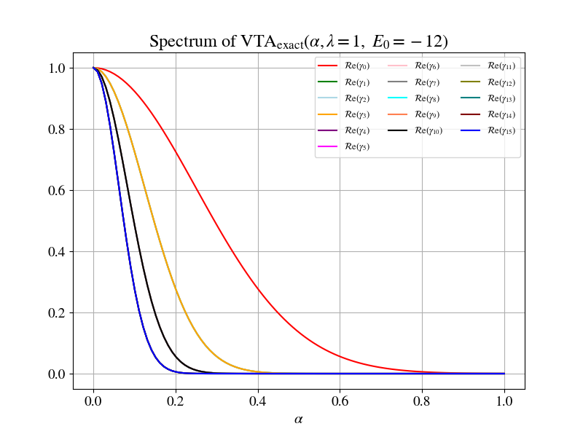
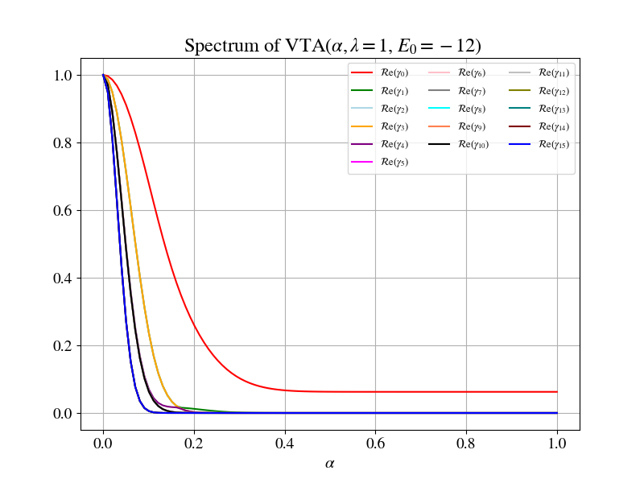
Spectrum for λ=1, E₀ = -12

Slide 22
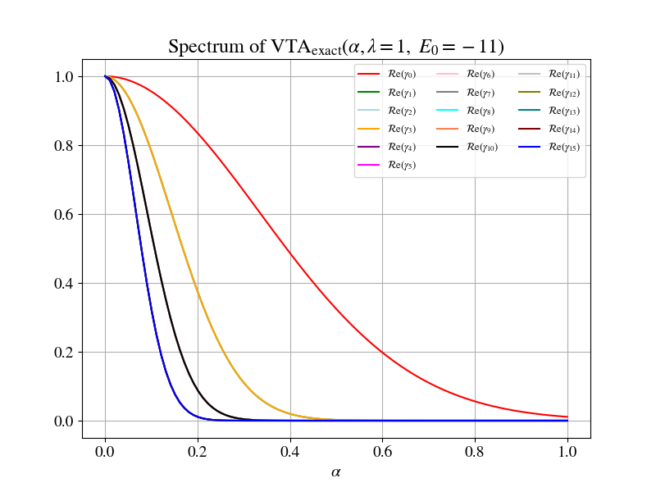
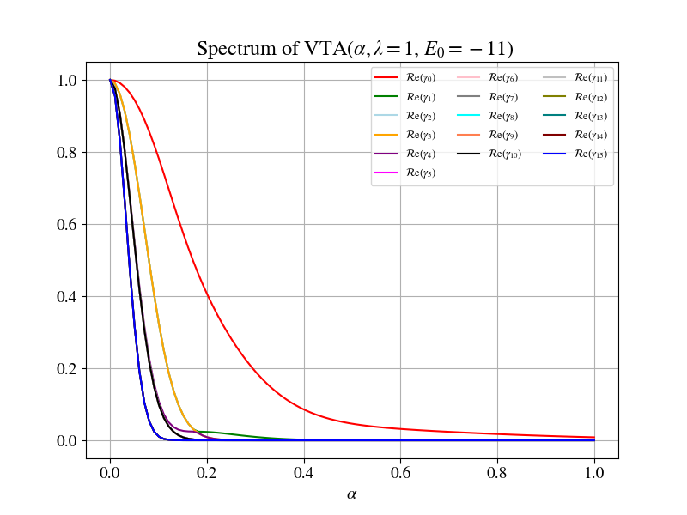
Spectrum for λ=1, E₀ = -11

Slide 23
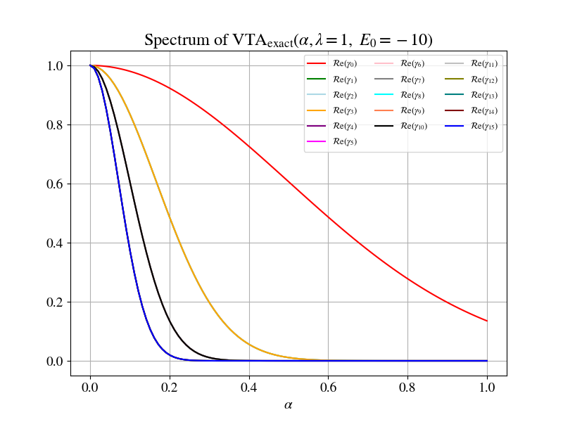
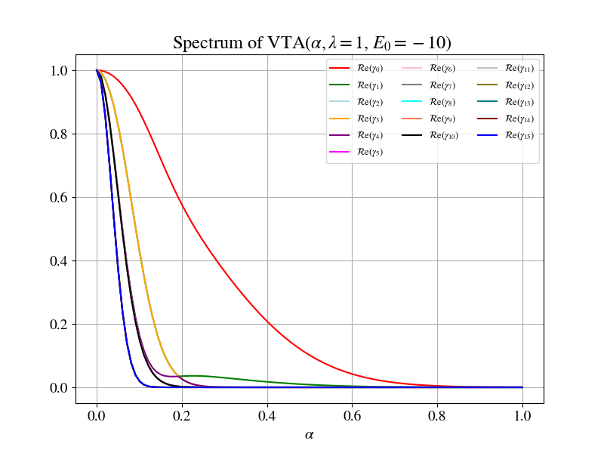
Spectrum for λ=1, E₀ = -10

Slide 24
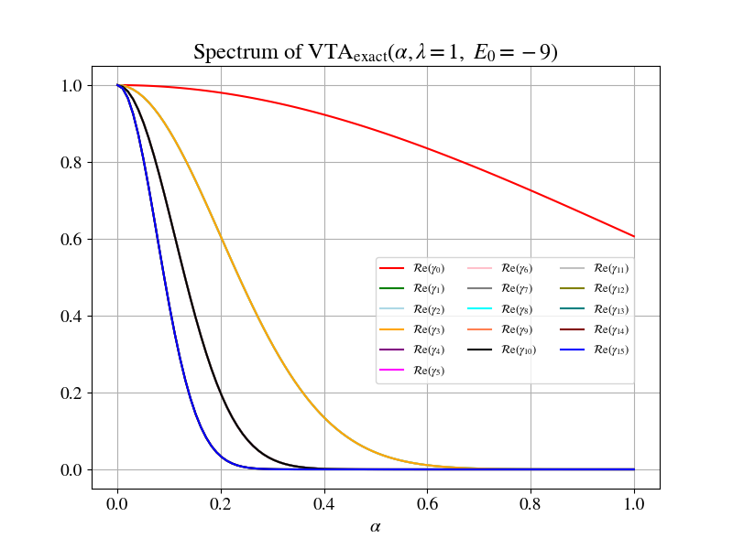
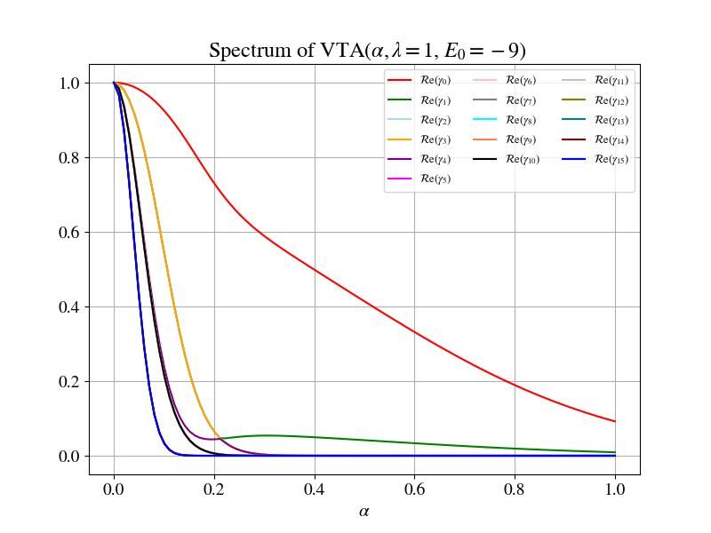
Spectrum for λ=1, E₀ = -9

Slide 25
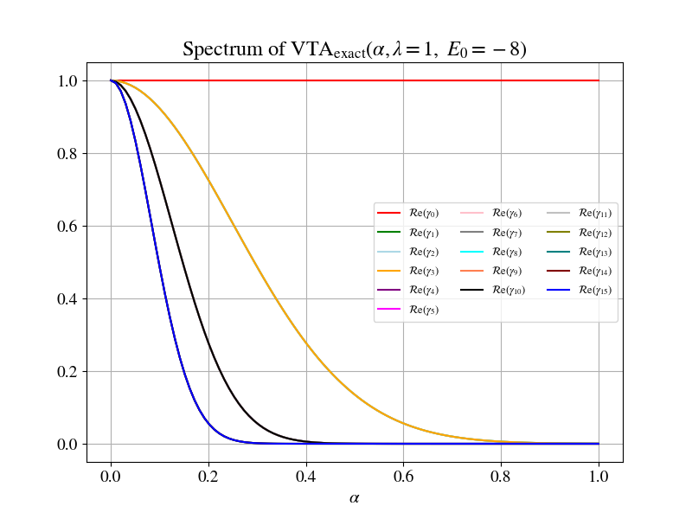
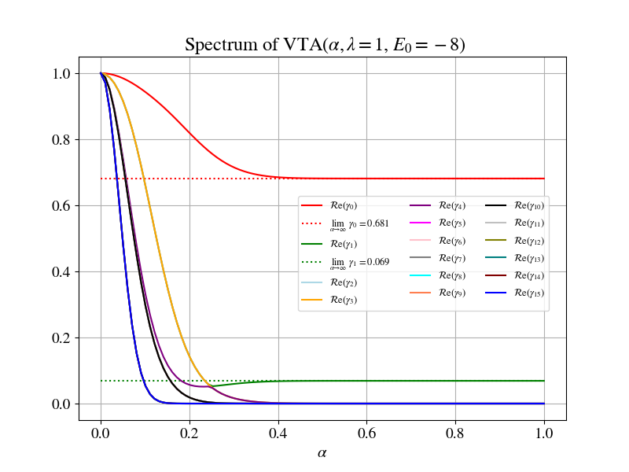
Spectrum for λ=1, E₀ = -8

Slide 26
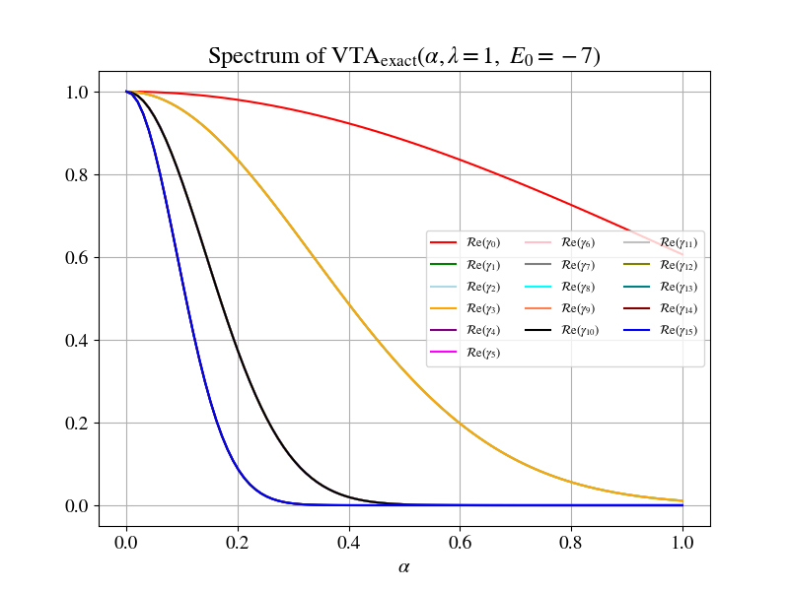
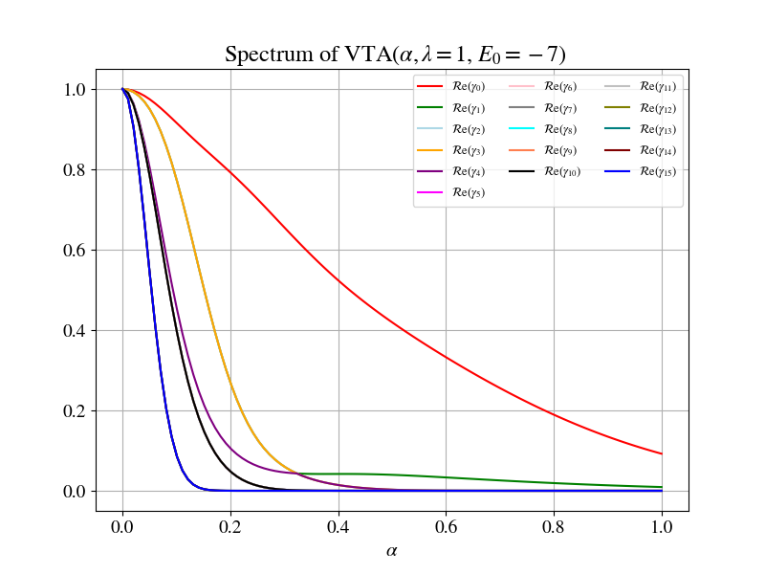
Spectrum for λ=1, E₀ = -7

Slide 27
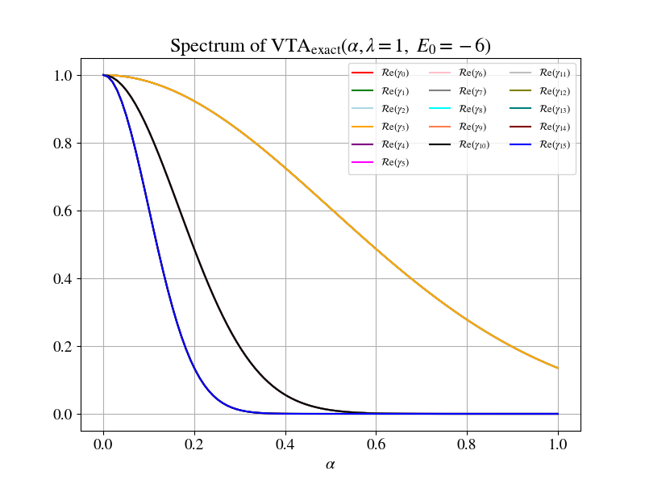
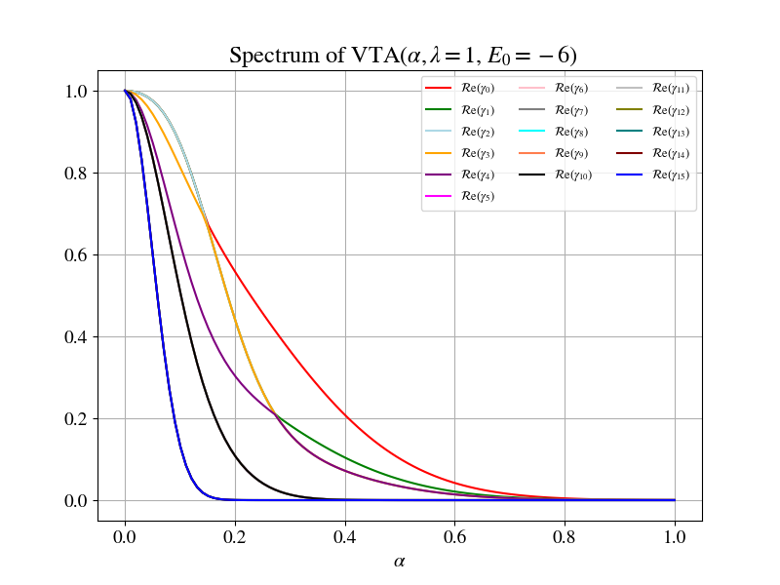
Spectrum for λ=1, E₀ = -6

Slide 28
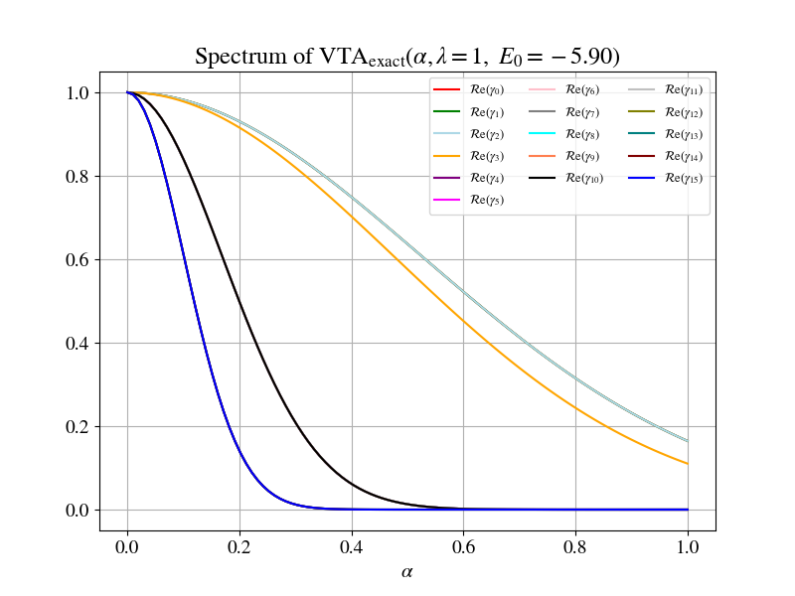
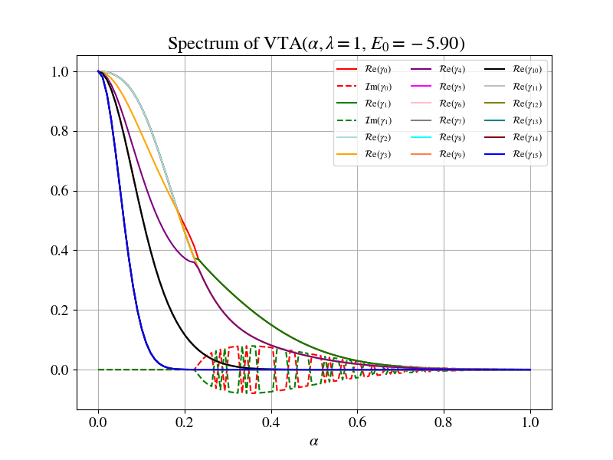
Spectrum for λ=1, E₀ = -5.9

Slide 29
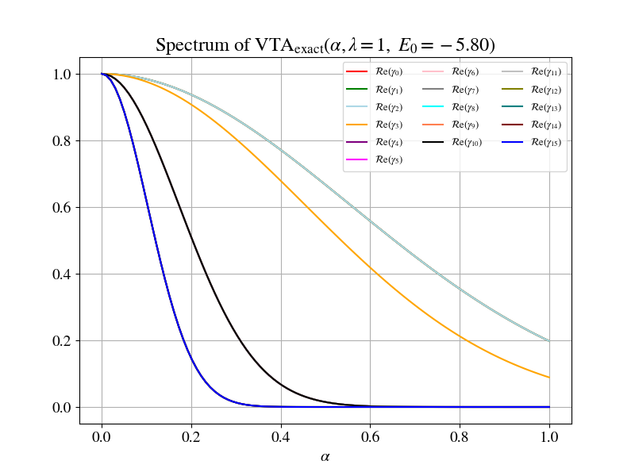
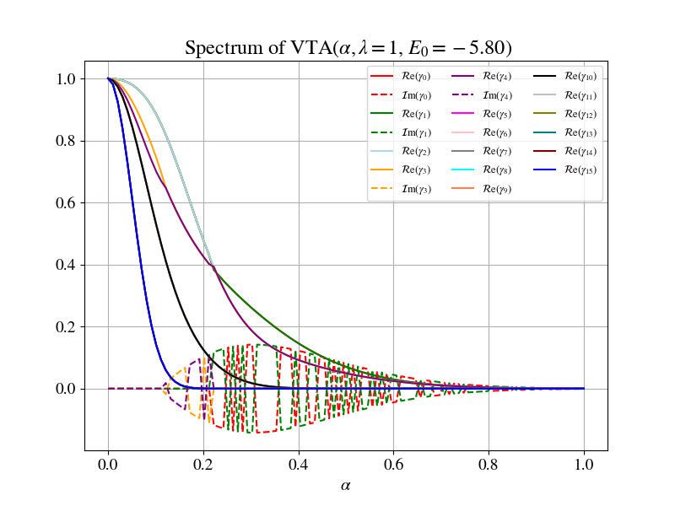
Spectrum for λ=1, E₀ = -5.8

Slide 30
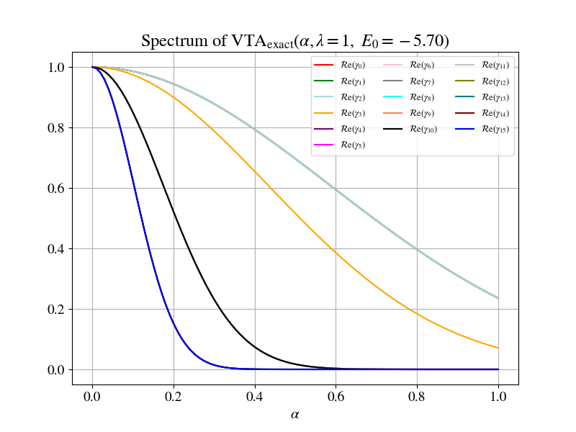
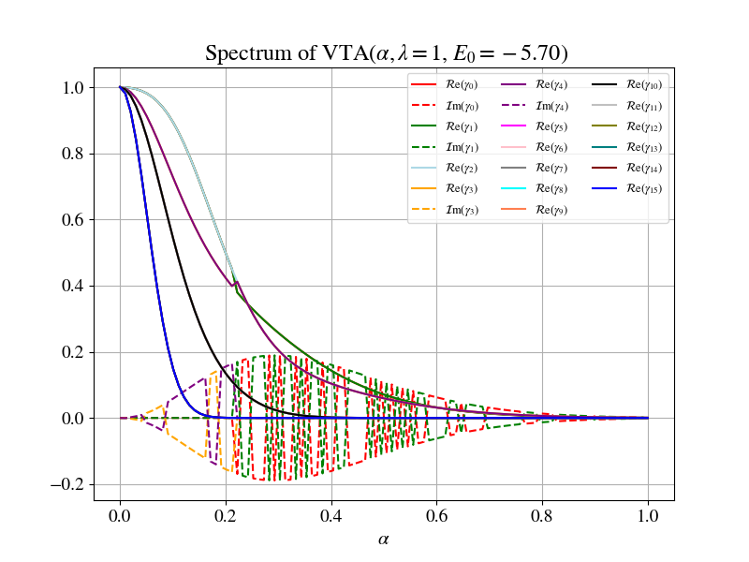
Spectrum for λ=1, E₀ = -5.7

Slide 31
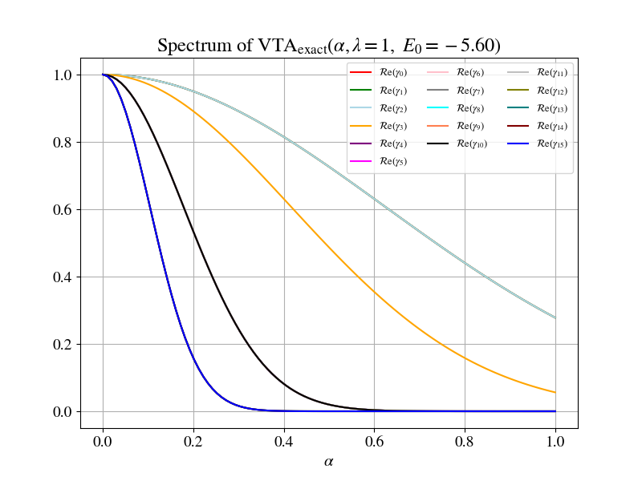
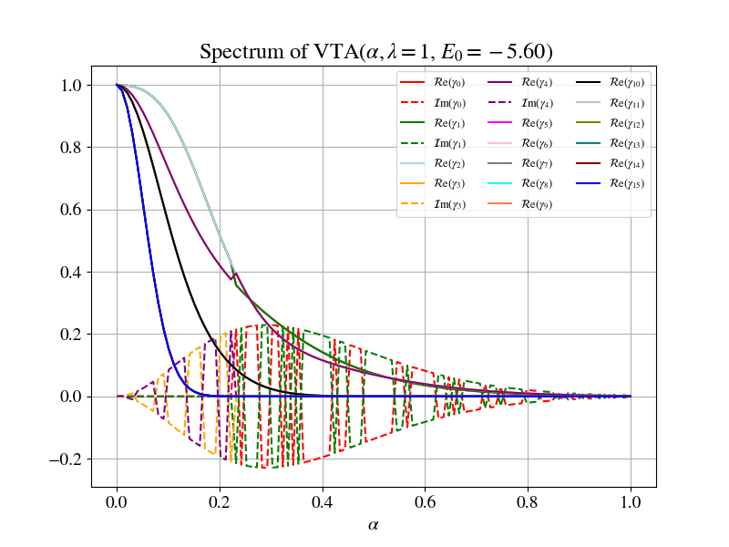
Spectrum for λ=1, E₀ = -5.6

Slide 32
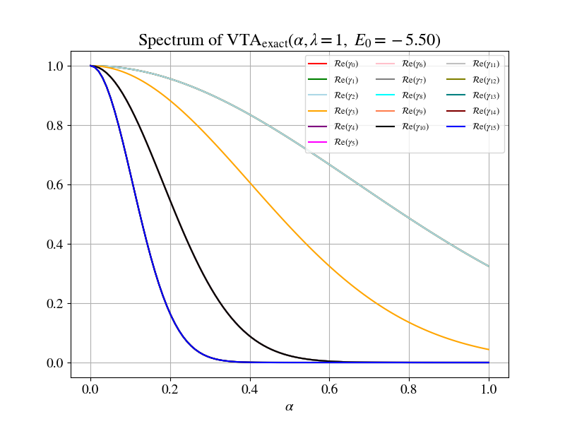
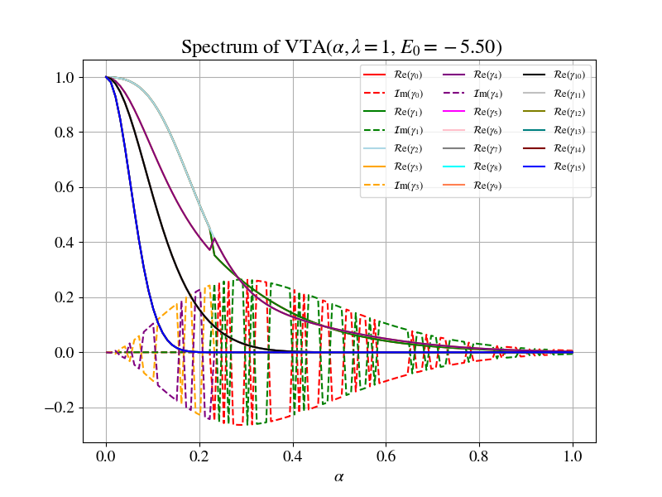
Spectrum for λ=1, E₀ = -5.5

Slide 33
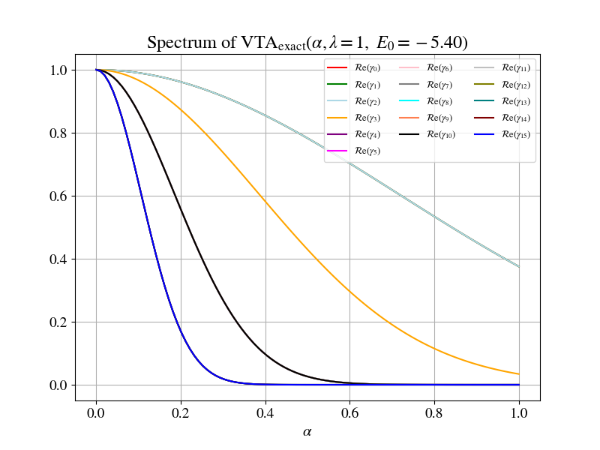
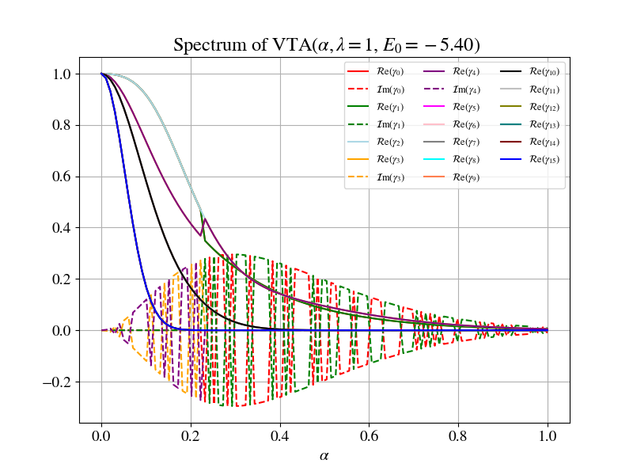
Spectrum for λ=1, E₀ = -5.4

Slide 34

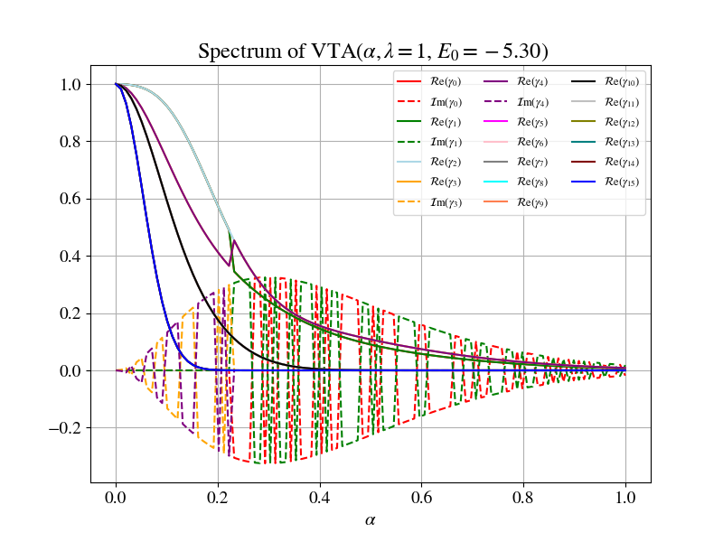
Spectrum for λ=1, E₀ = -5.3

Slide 35
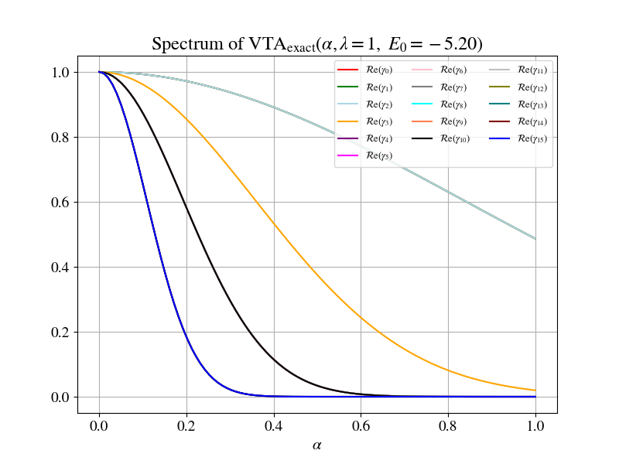

Spectrum for λ=1, E₀ = -5.2

Slide 36


Spectrum for λ=1, E₀ = -5.1

Slide 37


Spectrum for λ=1, E₀ = -5.0

Slide 38


Spectrum for λ=1, E₀ = -4.9

Slide 39


Spectrum for λ=1, E₀ = -4.8

Slide 40


Spectrum for λ=1, E₀ = -4.7

Slide 41


Spectrum for λ=1, E₀ = -4.6

Slide 42


Spectrum for λ=1, E₀ = -4.5

Slide 43


Spectrum for λ=1, E₀ = -4.4

Slide 44


Spectrum for λ=1, E₀ = -4.3

Slide 45


Spectrum for λ=1, E₀ = -4.2

Slide 46


Spectrum for λ=1, E₀ = -4.1

Slide 47


Spectrum for λ=1, E₀ = -3.9

Slide 48


Spectrum for λ=1, E₀ = -3.8

Slide 49


Spectrum for λ=1, E₀ = -3.7

Slide 50


Spectrum for λ=1, E₀ = -3.6

Slide 51


Spectrum for λ=1, E₀ = -3.5

Slide 52


Spectrum for λ=1, E₀ = -3.4

Slide 53


Spectrum for λ=1, E₀ = -3.3

Slide 54


Spectrum for λ=1, E₀ = -3.2

Slide 55


Spectrum for λ=1, E₀ = -3.1

Slide 56


Spectrum for λ=1, E₀ = -3.0

Slide 57


Spectrum for λ=1, E₀ = -2.9

Slide 58


Spectrum for λ=1, E₀ = -2.8

Slide 59


Spectrum for λ=1, E₀ = -2.7

Slide 60


Spectrum for λ=1, E₀ = -2.6

Slide 61


Spectrum for λ=1, E₀ = -2.5

Slide 62


Spectrum for λ=1, E₀ = -2.4

Slide 63


Spectrum for λ=1, E₀ = -2.3

Slide 64


Spectrum for λ=1, E₀ = -2.2

Slide 65


Spectrum for λ=1, E₀ = -2.1

Slide 66


Spectrum for λ=1, E₀ = -2.0

